Slide 1

Property Investment in Summit County
John Wertz

Slide 2
Why Summit County?

Slide 3
Summit County
Summit County is one of 64 counties in the state of Colorado.
Population 28,000 as of 2010 census
5 Ski Resorts: Loveland, Breckenridge, A-Basin, Keystone, Copper
Approximately 7.1 million tourists (2017/2018)
Surrounded by National Forest (62 13ers)
Six cities: Montezuma, Dillon, Frisco, Silverthorne, Breckenridge, and Blue River
Multiple Communities: Wildernest, Summit Cove, Keystone, Copper Mountain, Gold Run, Dillon Valley,

Slide 4
Activities:
Winter:
Summer:
Alpine and Nordic Skiing | Snow Festivals
Sledding/Tubing
Ski Events
Hiking | Boating/Rafting | Camping
Biking | Festivals
Fishing | Rock Climbing

Slide 5
Mission Statement:
Build a model utilizing property and rental data to make informed property investment in Summit County that will maximize my return to value.
Data collected was from the following:
MLS public record database
Carbonate Real Estate
AirBnB
Skyrun

Slide 6
Process:
Data Gathering
Public Information
Linear Regression
Property Management
Online Rental Website
Data
Wrangling
EDA
Visualization
Modeling

Slide 7
Data Gathering:
AirBnB:
Build an API wrapper to call AirBnB website to extract information based on city, state information.
Returned the following data:
Propertied | Property_Type | Rate_Type
Bedroom | City | Rate
Bathroom | Latitude | Min_Night
Person_Capacity | Longitude | Max_Night

Slide 8
Data Gathering:
Carbonate Real Estate:
Printout of 2018 and 2019 property information: Create an excel database.
Data includes:
Property Table:
Rate Table:
Property_Id | Bedroom | Latitude
Property_Name | Bathroom | Longitude
Unit | Sleep | Rate_Catagory (fk)
Rate_Catagory (pk) | Start_Date | End_Date

Slide 9
Data Gathering:
Skyrun Real Estate:
Printout of 2019 property information: Create an excel database.
Data includes:
Property_Id | Bedroom | Latitude
Property_Name | Bathroom | Longitude

Slide 10
Data Gathering:
Colorado MLS:
Download Public Record: 2017 to 2019
Captured the following data:
Tax_Id | Property_Type | Year_Built
Address | Beds | Sale_Date
City | Baths | Last_Sale_Price
Property_Zip | Sqft

Slide 11
Data Gathering:
CO Census Tract Boundaries:
Downloaded 5 census tract boundaries that are contained within Summit County
Extracted the outer borders to create a Summit County border for visualization purpose:
(GeoJson Data)

Slide 12
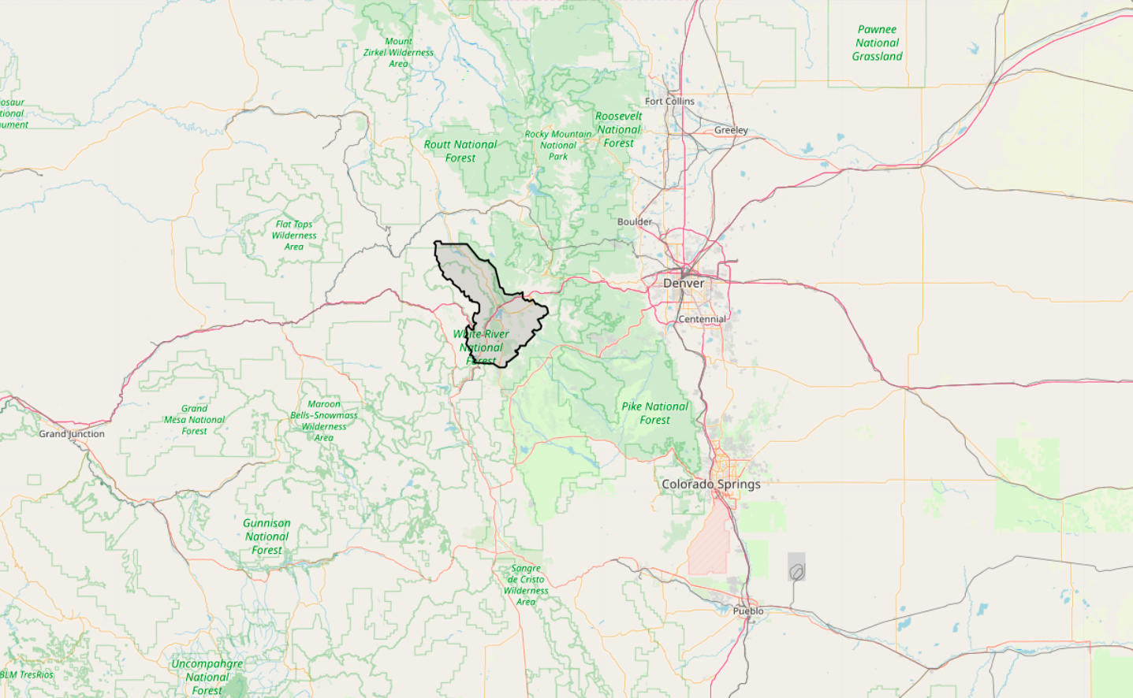
Denver International Airport
90 miles

Slide 13
Winter Park
Steamboat
Denver International Airport
90 miles
Vail

Slide 14
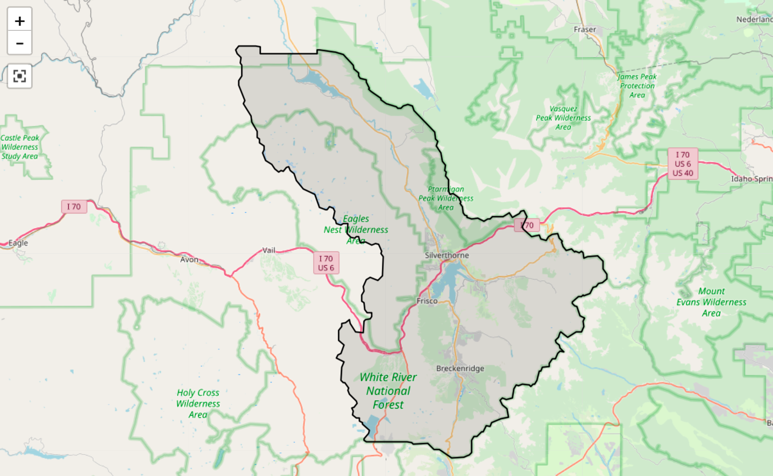
Summit County

Slide 15
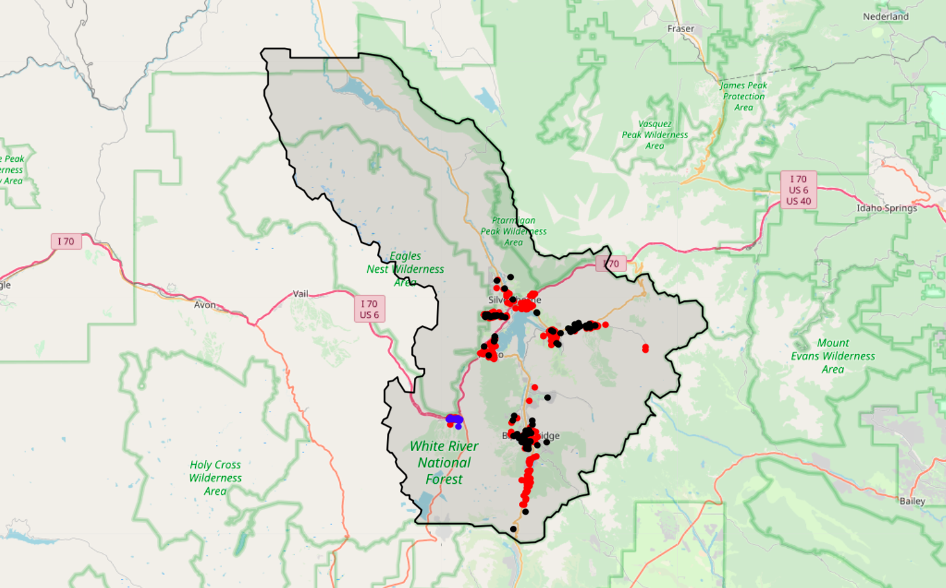
Summit County
Rental Plots

Slide 16
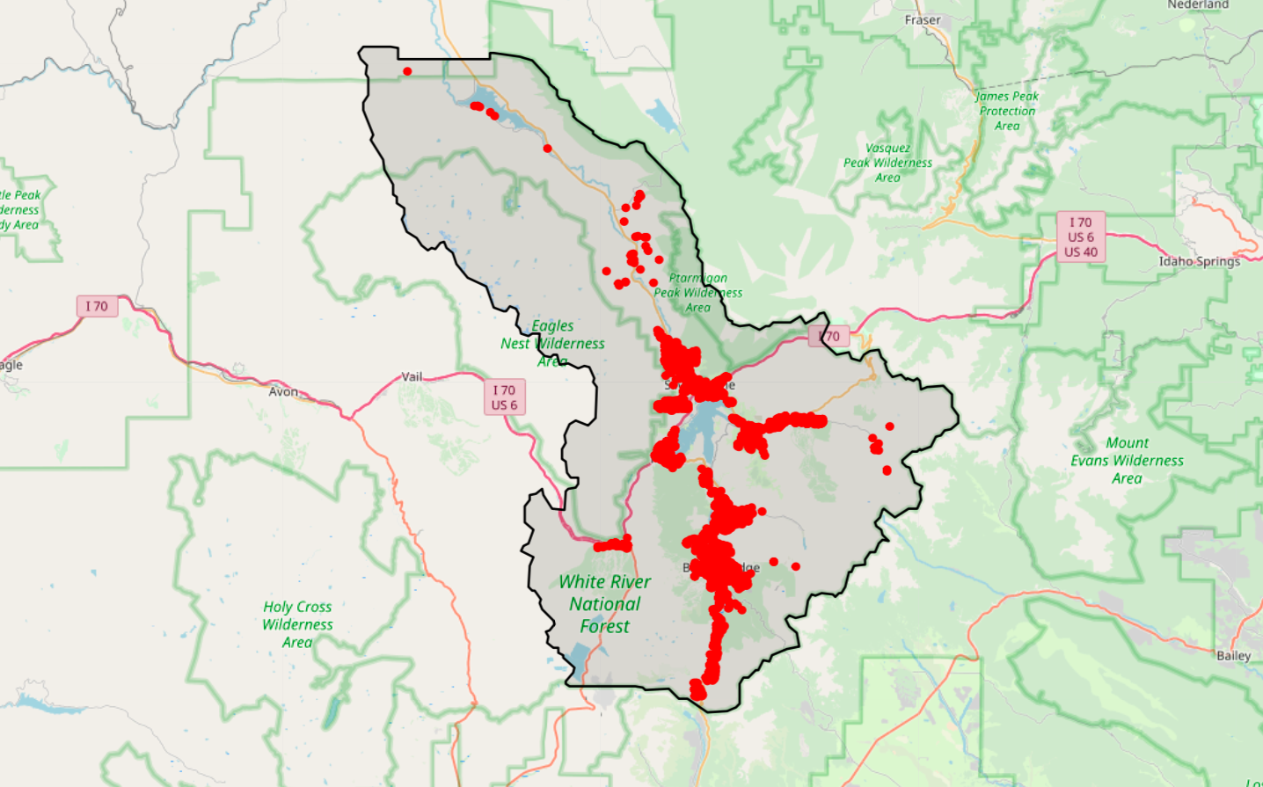
Summit County
Property Sales Plots
2017 - 2019

Slide 17
Data Wrangling
Visual inspect the data
Remove outliers
Remove data anomalies

Slide 18
Histogram and Box Plots

Slide 19
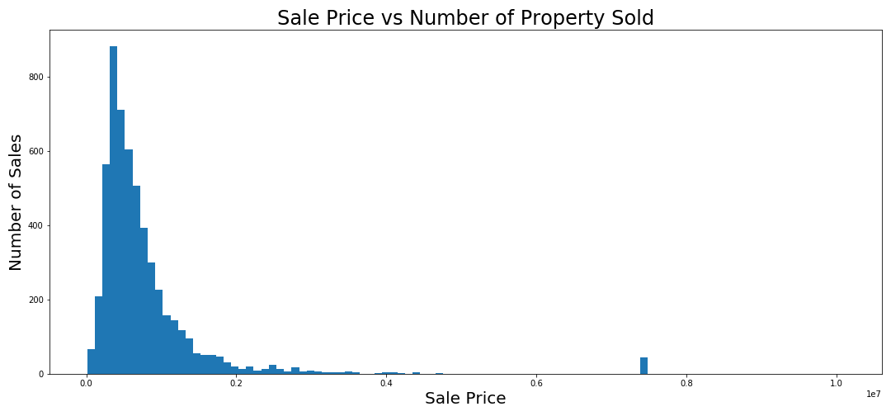

Slide 20
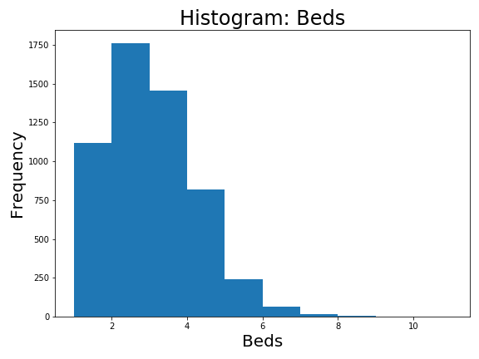

Slide 21
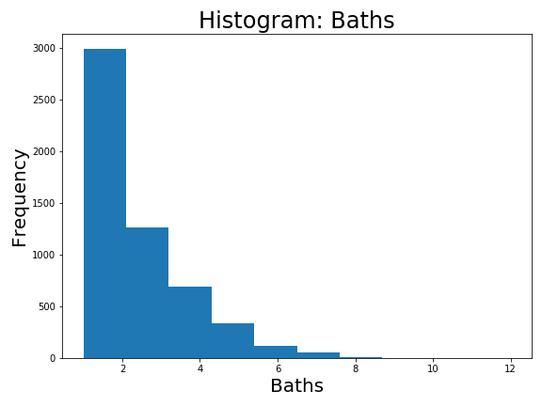

Slide 22
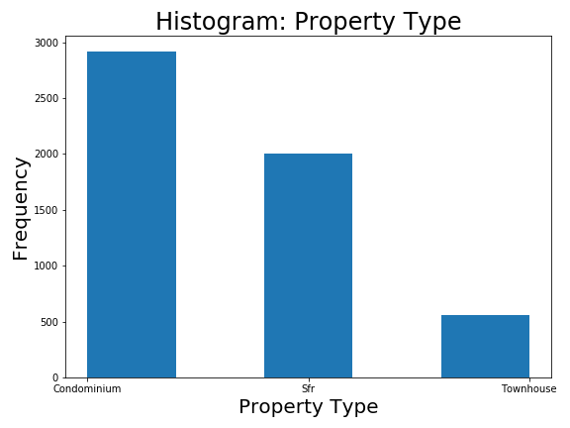

Slide 23
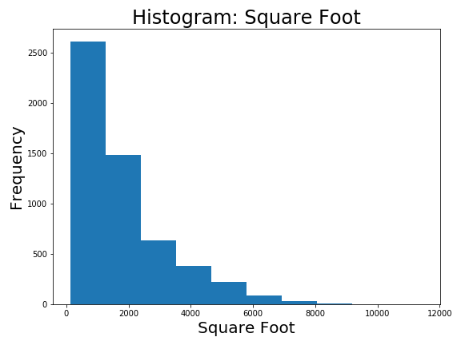

Slide 24
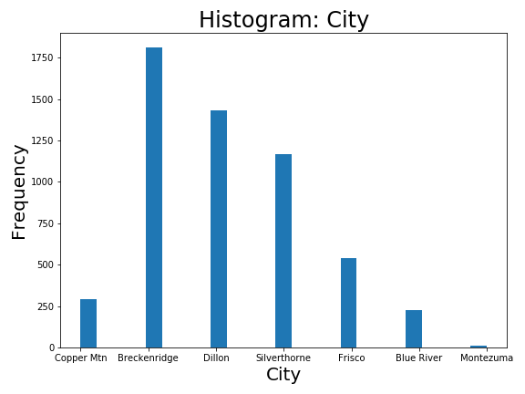

Slide 25
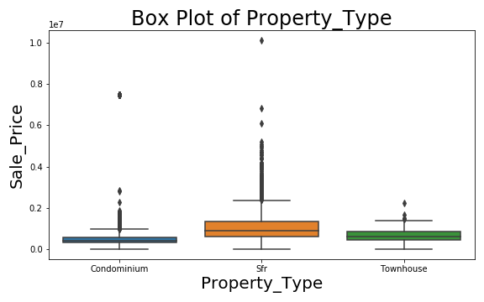

Slide 27
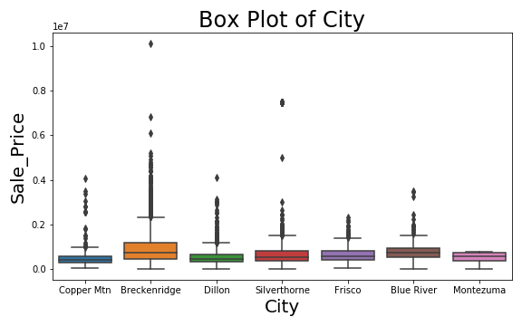

Slide 29
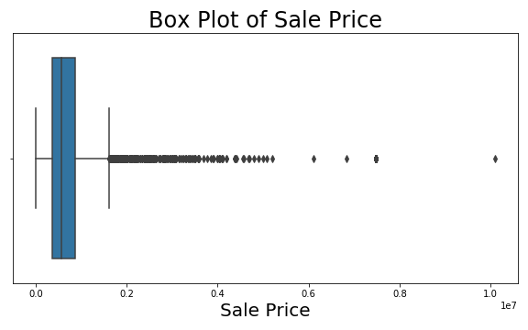

Slide 30
Correlation Graphs

Slide 31
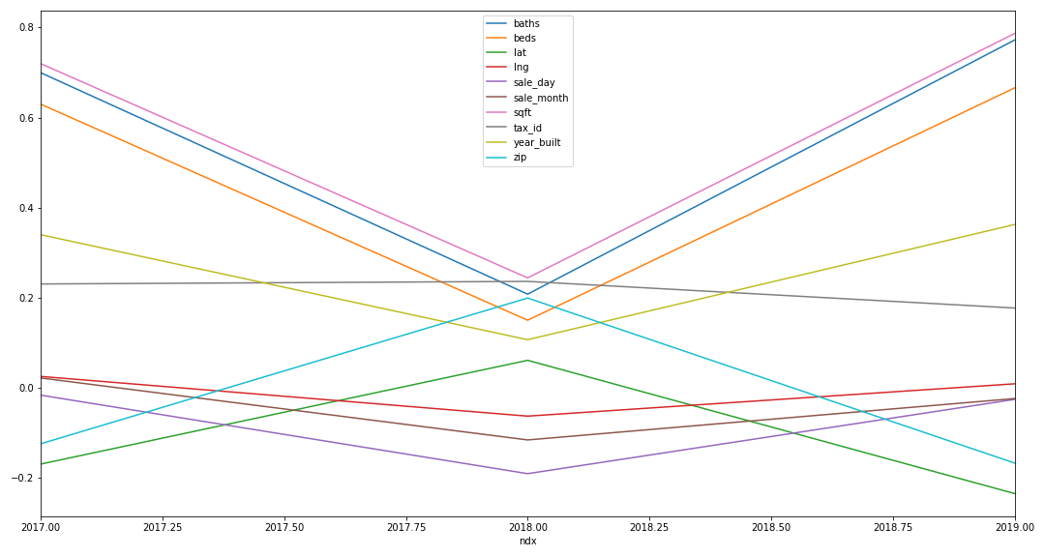
Correlation by Year

Slide 32
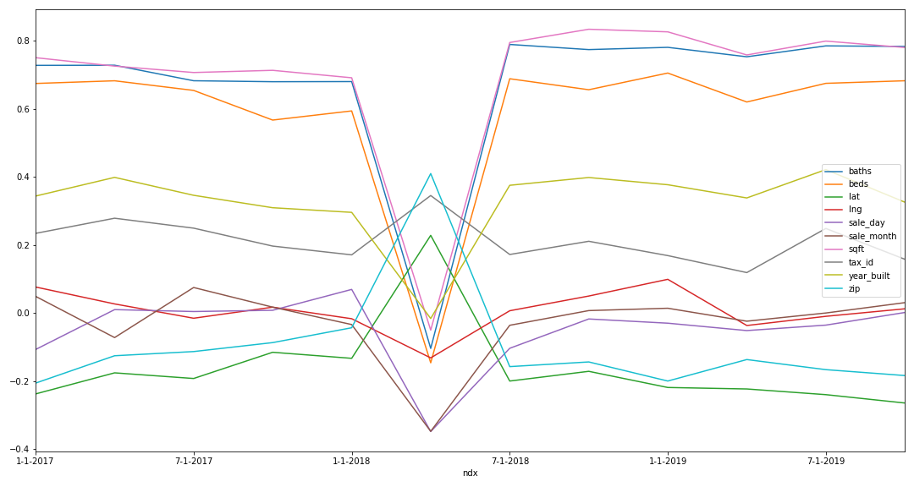
Correlation by Quarter

Slide 33
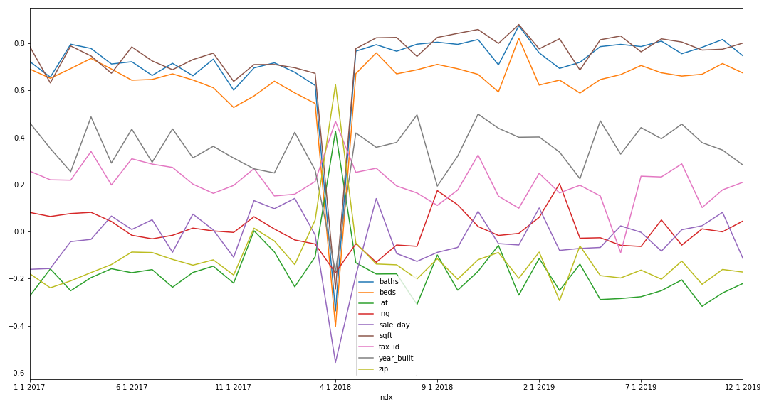
Correlation by Month

Slide 34
Data Outliers
From the correlation graphs I narrowed down to a specific date on April 5, 2018.
Data:
30 properties: 1 bed and 1 bath condominium each sold for $7,500,000
Further research found that the building was sold for 7.5 million. The information was attached to each condominium in the building.

Slide 35
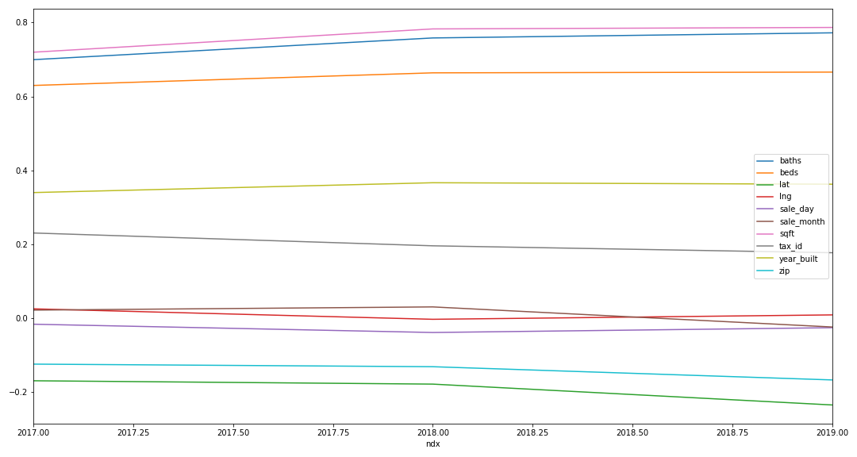
Correlation by Year

Slide 36
Data Limitations:
Upper Limits:
For the purpose of this mission, we want to limit our price range to under $ 1 million.
We will want to remove outliers and any properties over $ 1 million.

Slide 37
Data Irregularities
During my EDA, I have come across some data irregularities.
For example:
4-bedroom, 4-bathroom, 3905 sqft, single family residence in Silverthorne. Built in 2018 was sold for $11,386 on 2/8/2019. (id: 6517415)
1-bedroom, 1-bathroom, 672 sqft, condominium in Dillon. Built in 1972 was sold for $20,000 on 12/9/2019. (id: 900513)
3-bedroom, 3-bathroom, 2142 sqft, single family residence in Dillon. Built in 1996 was sold for $80,000 on 4/25/2017. (id: 1001305)

Slide 38
Data Limitations:
Lower Limits:
To attempt some balance to remove lower outliers, we want to remove any properties under $ 100,000.

Slide 39
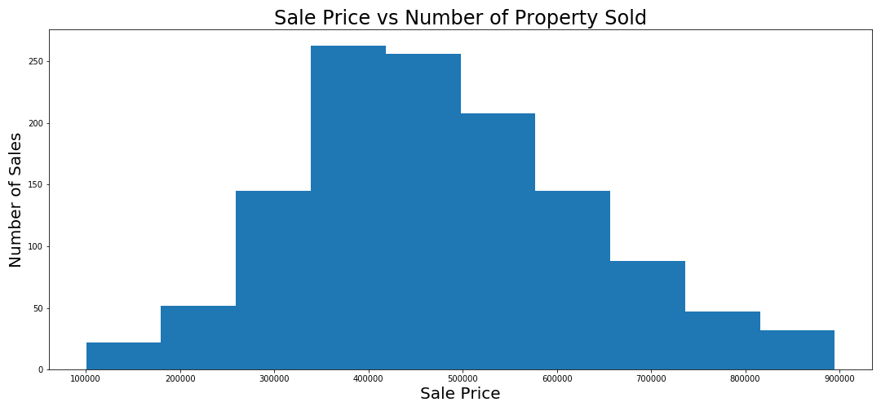

Slide 40
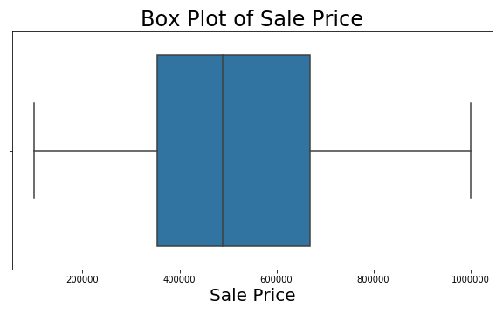

Slide 41
Concerns
At this point, I am concerned about the quality of the data.
I have found some anomalies and those that was easy to find were removed in both upper and lower range.
What I can’t address is the quality of the data within the lower and upper bound.

Slide 42
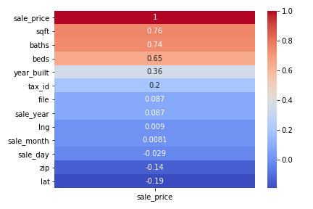
Modeling
I utilized a Linear Regression model using the following features:
Beds
Baths
Sqft

Slide 43
Model:
Baseline:
Utilized original data (before removing the outliers)
Training Score: 0.2718
Testing Score: 0.1727

Slide 44
Model:
Model 2:
Utilized data after removing the outliers
Training Score: 0.5984
Testing Score: 0.6192

Slide 45
Feature Engineering:
To try to add more features, we can breakout the cities and property types by dummying the fields.
A process where it convert categorical data into numerical variable.

Slide 46
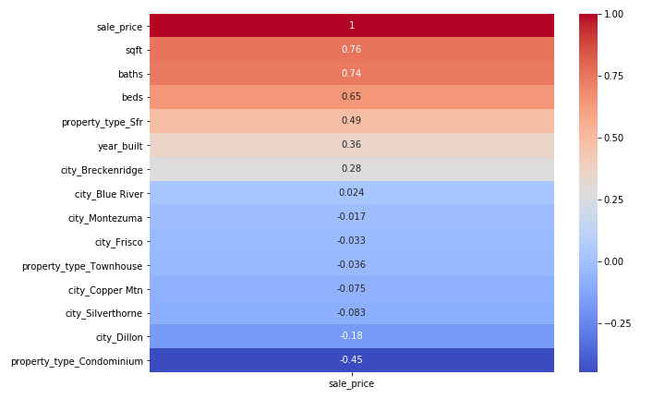
Correlation Map:

Slide 47
Correlation Map:

Slide 48
Model
Model 3:
Add in the Property_Type_Sfr with beds, baths, and sqft
Training Score: 0.6017
Testing Score: 0.6207

Slide 49
Cluster The Datasets
Another way to process the data is to cluster the datasets to see if it would help with the model:
Reason for this is due to how some area are defined.
Example:
Copper Mountain share the zip code with Frisco
Blue River share the zip code Breckenridge
Keystone share the zip code with Dillon

Slide 50
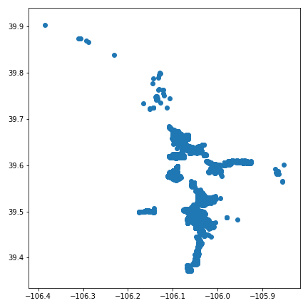
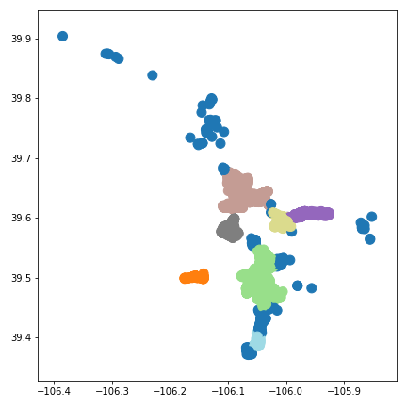
DBSCAN

Slide 51
DBSCAN
Silverthorne
Dillon
Keystone
Frisco
Copper Mountain
Blue River
Breckenridge

Slide 52
DBSCAN
Silverthorne
Wildernest
Dillon
Keystone
Frisco
Copper Mountain
Blue River
Breckenridge

Slide 53
Model by Clusters
Utilized data only within the clusters:
Beds, baths, sqft, property_type
Model 4:
Training Score: 0.6117
Testing Score: 0.5967

Slide 54
Model
Last attempt by separating the data by the year sold:
Model 5-7
Year 2017 | Year 2018 | Year 2019
Training Score: 0.5732 | Training Score: 0.6293 | Training Score: 0.6539
Testing Score: 0.5008 | Testing Score: 0.4706 | Testing Score: 0.6316

Slide 55
Model
Last attempt by separating the data by the year sold:
Model 5-7
Year 2017 | Year 2018 | Year 2019
Training Score: 0.5732 | Training Score: 0.6293 | Training Score: 0.6539
Testing Score: 0.5008 | Testing Score: 0.4706 | Testing Score: 0.6316

Slide 56
Model
Last attempt by separating the data by the year sold:
Model 5-7
Year 2017 | Year 2018 | Year 2019
Training Score: 0.5732 | Training Score: 0.6293 | Training Score: 0.6539
Testing Score: 0.5008 | Testing Score: 0.4706 | Testing Score: 0.6316

Slide 57
Rental Data
Data Analysis:
Properties are running about 43% occupancy for the 2019 calender year.
(1 bed/1 bath and 2 bed/2bath)
Majority of the rental occurs during the ski season between Nov 10 through April 15.
Peak Rental Rates during x-mas and new years week.
Second Peak is during March and President Day.
Base rate is during the non-ski season.

Slide 58
Rental Data
Data Analysis:
Average Potential Gross Revenue for:
1 bedroom and 1 bathroom: $37,800
2 bedroom and 2 bathroom: $50,890
3 bedroom and 3 bathroom: $44,000
(lower occupancy rate)

Slide 59
Rental Data
Data Analysis:
Average Potential Gross Revenue for:
1 bedroom and 1 bathroom: $37,800
Difference: 13,090
2 bedroom and 2 bathroom: $50,890
Difference: -6,890
3 bedroom and 3 bathroom: $44,000
(lower occupancy rate)

Slide 60
Property Data
The average sale price in 2019:
1 bedroom and 1-2 bath: $350,600
2 bedroom and 1-3 bath: $513,300
3 bedroom and 2-4 bath: $784,600

Slide 61
Property Data
The average sale price in 2019:
1 bedroom and 1-2 bath: $350,600
Difference: 162,700
2 bedroom and 1-3 bath: $513,300
Difference: 271,300
3 bedroom and 2-4 bath: $784,600

Slide 62
Conclusion
Based on the data I was able to collect and analyze, I would target the following:
2 bedroom/1-3 baths property as my primary goal
1 bedroom/1-2 baths property as my secondary
Potentially I can get a yearly return of $50,000 for a 2/2 property.
However, I was only able to achieve 65% score from my linear regression model.
There is more data to gather and analyze before using the model as a tool for investment opportunities.

Slide 63
Future Improvements
More features should be included into the model such as:
Condition of Property
Condition of Appliances
Garage/Parking
Force Air/Boiler/Electric Heating
Association Dues
Hot Tub
Porch
Level
HOA

Slide 64
Future Improvements
Quality of the data:
I was disappointed in the quality of the data from the public records. I will need to investigate how to weed out the ‘true’ property sale from other type of transactions.
Need to differentiate the actual rental usage from the owner’s usage to get a true sense of rental market.
Need to collect more prior property data. I was unfortunate that I was restricted to gathering three years worth per month. Over time with enough data, I could map out the pricing trend.

Slide 65
Links:
http://www.co.summit.co.us/
https://www.airbnb.com/
https://en.wikipedia.org/wiki/Summit_County,_Colorado
https://data-cdphe.opendata.arcgis.com/datasets/a9f5b1a67bd74b2fa22279d141625335_3
https://industry.colorado.com/sites/default/files/COImp%20-%20with%20National.pdf
https://www.recolorado.com/

Slide 66
Special Thanks To:
Carbonate Real Estate
SkyRun Property Rental
To my cohorts for putting up with me:
Megha Zavar, Scott Rosengrants, Magnus Bigelow
To my instructors:
Noelle Brown, Riley Dallas, Matt Brems, Tim Book, and Kimberly English

